Slide 1

Project/Internship Approval Portal
Shri Vaishnav Vidyapeeth Vishwavidyalaya
Shri Vaishnav Institute of Information and Technology
Department of Computer Science Engineering
MINOR PROJECT
BTCS606
Team Members:
Guided By:
Radhika Gupta (18100BTBDAI02908)
Shantanu More (18100BTBDAI02922)
Vaibhavi Jadhav (18100BTBDAI02929)
Vivek Maltare (18100BTBDAI02931)
Mr. Chetan Chauhan

Slide 2
Project analysis slide 2
Presentation Insights
INTRODUCTION
ABSTRACT
Project/Internship
Approval Portal
INSIGHTS
(APPROVSY)
LITERATURE REVIEW
UML DIAGRAMS

Slide 3
Project analysis slide 4
INTRODUCTION
In this project, we will be covering two different aspects. The one being project management and the other being internship management.
The module of Project management will focus mainly on automating the process of project submission. In the sense, projects topics will be submitted online along with docs and approval will be provided online by the head of department along with suggestions if any .
This will reduce the physical efforts of students meeting Head of Department’s and also reduce the time frame period of completing this part of project work. Students can also update their project status weekly and provide information regarding the projects which will be monitored by all the relevant professors and head of department. It will be useful for students related to any educational field.
The module of Internship management will enable the university students to apply for internship programs. Through this interface the students shall be able to view the available positions for internship , allowing the university to collect applicants data , review that data , make a decision and then continue to interact with applicants and reviewers. The goal of the system is to enable online interactions with applicants and their supervisors and automate the entire process , thereby eliminating a huge amount of paperwork's and manual tasks.

Slide 4
Project analysis slide 4
ABSTRACT
We live in a jet age when results are expected to turn in speedily as evident in various fields of study such as engineering where this concept of Computers has made a tremendous impact. Computer Technology has an enormous impact on educational sector making it easy to exact a kind of intelligence that transcends human ability naturally. With the availability of computer system, most institutions has access to internet facilities which is also a necessity. Universities though still use papers and manual processes for managing internships and student projects, adapting the traditional way.
Our “Project/Internship Approval portal” is a system built to automate the process of collecting, reviewing and managing applications for internships, approve it as well as managing the throughout lifecycle of a project submission.
The application deals with ease of students thereby reducing the tedious paper work and ensuring better services for students as well as faculties. It will also help us saving the environment by saving the papers.

Slide 5
Project analysis slide 4
ABSTRACT
Using this application a person can make their work easy by managing and submitting their projects and internship applications whenever and wherever.
This application will guide them properly about their topics , project related future submissions and new internships by automatically notifying them.
Encapsulating the above, our project “Internship/Project Approval portal” will guide students in interacting with their respective faculties digitally and helping them manage their projects and internships related information easily.”

Slide 6
Project analysis slide 7
Comparative Study
PRODUCTS
Team Work | Project.co | Open Project | ProjectoryX | Approval Bus | WorkEp | Hubbion | Infolio | Wrike | APPROVSY
✓ | ✓ | ✓ | ✓ | ✓ | ✓ | ✓ | ✓ | ✓ | ✓
✓ | ✓ | ✗ | ✗ | ✓ | ✓ | ✓ | ✗ | ✓ | ✓
✓ | ✓ | ✗ | ✗ | ✓ | ✗ | ✓ | ✓ | ✓ | ✓
✓ | ✓ | ✓ | ✓ | ✓ | ✗ | ✓ | ✓ | ✓ | ✓
✗ | ✗ | ✓ | ✗ | ✗ | ✗ | ✗ | ✓ | ✗ | ✓
✓ | ✓ | ✓ | ✓ | ✓ | ✓ | ✓ | ✓ | ✓ | ✓
✓ | ✓ | ✓ | ✗ | ✗ | ✓ | ✓ | ✓ | ✓ | ✓
✓ | ✓ | ✓ | ✓ | ✓ | ✓ | ✓ | ✓ | ✓ | ✓
Quality Control
Document Management
Data transfer reliability
Clear feedback process
Role based authentication
Ongoing support
Platform independent
User Friendly
FEATURES

Slide 7
Project analysis slide 7
PRODUCTS
Team Work | Project.co | Open Project | ProjectoryX | Approval Bus | WorkEp | Hubbion | Infolio | Wrike | APPROVSY
Portability
Progress monitoring
Chat box
Hit counter
Accuracy
Browser compatibility
Add banner
Security
✓ | ✓ | ✓ | ✗ | ✓ | ✓ | ✓ | ✓ | ✓ | ✓
✓ | ✓ | ✓ | ✓ | ✗ | ✗ | ✓ | ✓ | ✓ | ✓
✗ | ✓ | ✗ | ✗ | ✓ | ✗ | ✓ | ✓ | ✗ | ✓
✗ | ✗ | ✗ | ✓ | ✗ | ✗ | ✓ | ✗ | ✗ | ✗
✓ | ✓ | ✓ | ✓ | ✓ | ✓ | ✓ | ✓ | ✓ | ✓
✓ | ✗ | ✗ | ✓ | ✗ | ✗ | ✓ | ✗ | ✓ | ✓
✓ | ✗ | ✗ | ✗ | ✗ | ✗ | ✗ | ✗ | ✗ | ✗
✓ | ✓ | ✓ | ✓ | ✓ | ✗ | ✓ | ✓ | ✓ | ✓
FEATURES

Slide 8
PRODUCTS
Team Work | Project.co | Open Project | ProjectoryX | Approval Bus | WorkEp | Hubbion | Infolio | Wrike | APPROVSY
Student Portfolio
Internship alerts
Formal Platform For University
Employer Student Connectivity
Important Announce-ment/ Notices
Student Group Info
✗ | ✗ | ✗ | ✗ | ✓ | ✓ | ✓ | ✓ | ✓ | ✓
✗ | ✗ | ✗ | ✗ | ✗ | ✗ | ✗ | ✗ | ✗ | ✓
✗ | ✗ | ✗ | ✗ | ✗ | ✗ | ✗ | ✗ | ✗ | ✓
✗ | ✗ | ✗ | ✓ | ✗ | ✗ | ✓ | ✗ | ✗ | ✓
✗ | ✗ | ✗ | ✓ | ✓ | ✗ | ✗ | ✗ | ✓ | ✓
✗ | ✗ | ✗ | ✗ | ✗ | ✗ | ✗ | ✗ | ✗ | ✓

Slide 9

UML DIAGRAMS
USE CASE DIAGRAM
ACTIVITY DIAGRAM
STATE DIAGRAM
SEQUENCE DIAGRAM

Slide 10
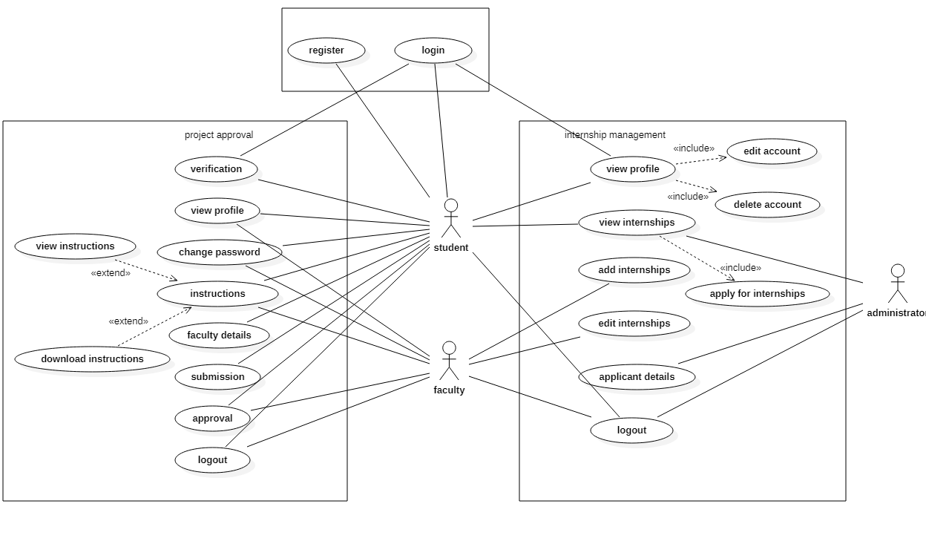
Project analysis slide 4
USE CASE DIAGRAM

Slide 11
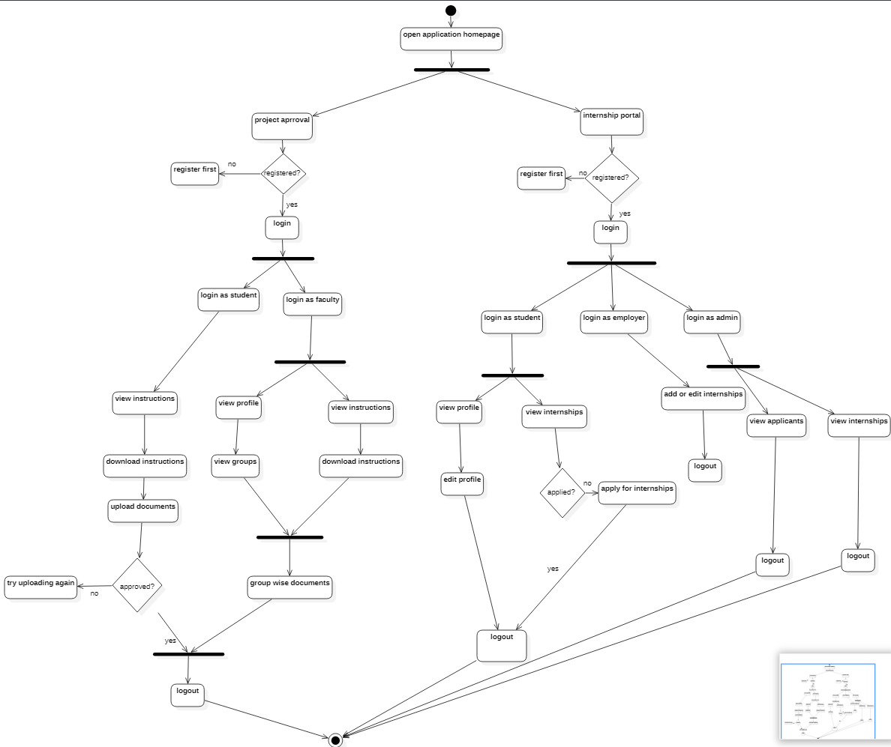
Project analysis slide 4
ACTIVITY
DIAGRAM

Slide 12
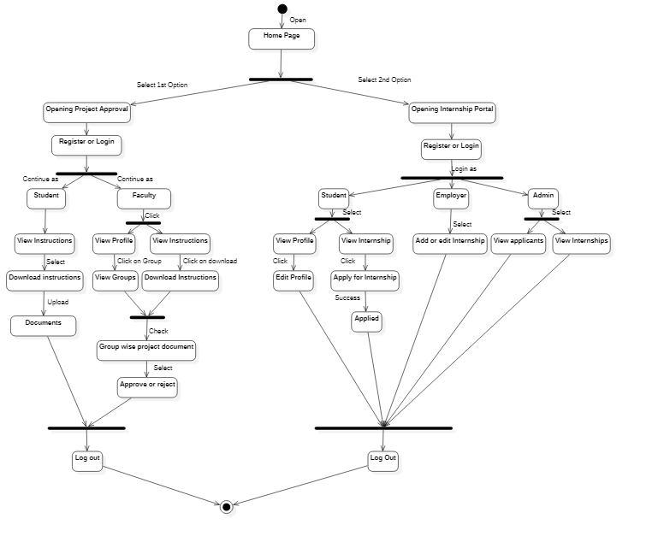
Project analysis slide 4
STATE
DIAGRAM

Slide 13
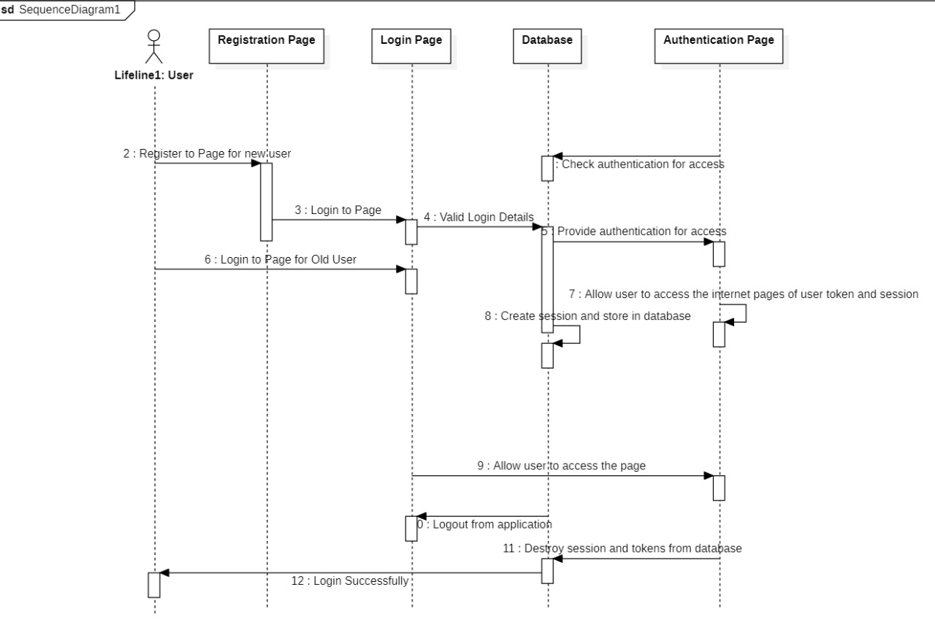
Project analysis slide 4
SEQUENCE
DIAGRAM
4.1

Slide 14
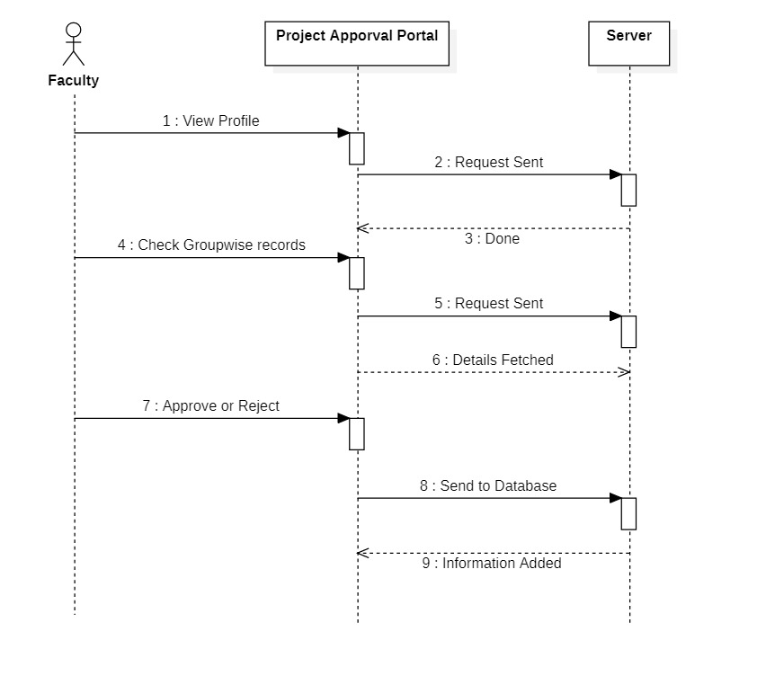
Project analysis slide 4
SEQUENCE
DIAGRAM
4.2

Slide 15
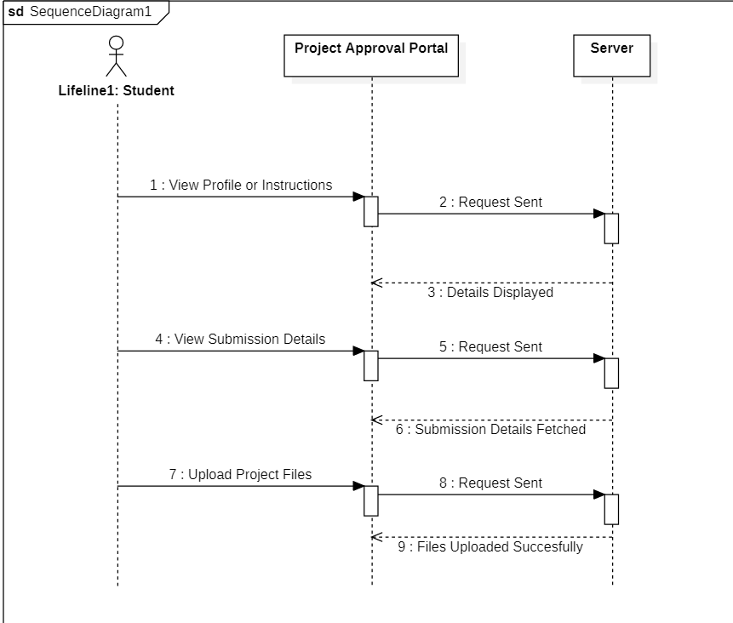
Project analysis slide 4
SEQUENCE
DIAGRAM
4.3

Slide 16
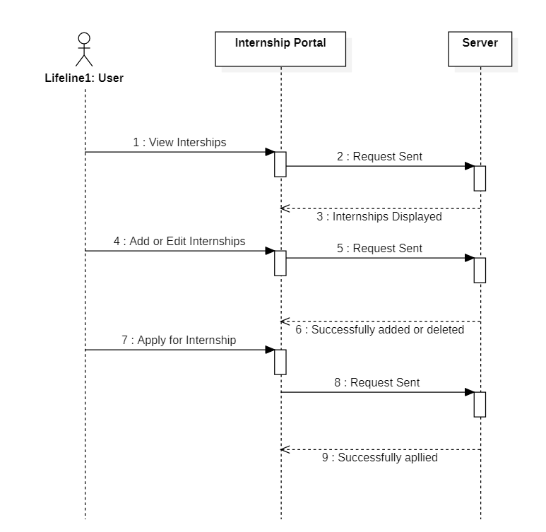
Project analysis slide 4
SEQUENCE
DIAGRAM
4.4

Slide 17
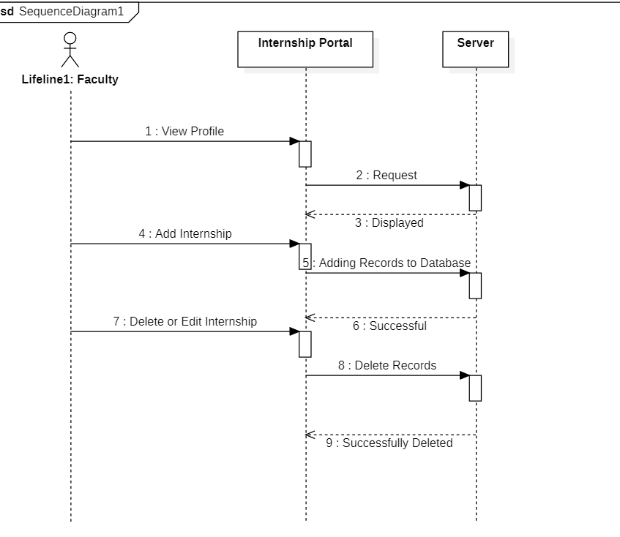
Project analysis slide 4
SEQUENCE
DIAGRAM
4.5

Slide 18
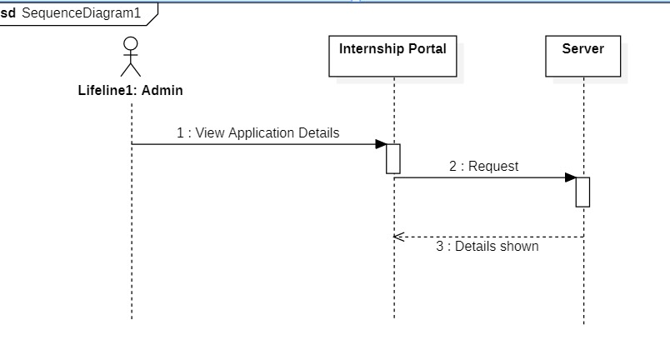
Project analysis slide 4
SEQUENCE
DIAGRAM
4.6

Slide 19
Thank You

